Slide 1
CS 310 DATA STRUCTURES
Manju Muralidharan
GMCS 566 9:30 – 11:00
mmuralidharanpriya@sdsu.edu
Notes:
Are your classroom colors different than what you see in this template? That’s OK! Click on Design -> Variants (the down arrow) -> Pick the color scheme that works for you!
Feel free to change any “You will…” and “I will…” statements to ensure they align with your classroom procedures and rules!

Slide 2
What is an Algorithm
An algorithm is a finite set of rules that give a sequence of operations for solving a specific type of problem.
- Donald Knuth

Slide 3
Euclid’s Algorithm
Used to find GCD of two positive integers
Consider two positive integers m and n, such that m>n
Step 1: Divide m by n and set the remainder to r
Step 2: If r=0 then the algorithm ends. GCD of m, n is n
Step 3: if r>o then set m->n and n->r . Repeat from Step 1 till r=0.

Slide 4
Why study Algorithms?
Gives us an idea of Running Time
Helps us decide on Hardware Requirements
What is feasible vs What is impossible
Improvement is a never-ending process

Slide 5
Why study Data Structures?
The ways in which we store Data
Helps Faster access and Faster Saving of Data
Example : Books in a Library
Heaps & Piles vs Racks
Random organization vs Ordered

Slide 6
Picking Data Structures
Which Operation is done more frequently
Which Operation needs to be faster than the others
In other words : Represent data efficiently

Slide 7
In This Course
Analysis of Algorithms
Stacks & Queues
LinkedLists
Sorting Algorithms
Binary Trees
Binary Search Trees
Heaps
Searching & Hashing
Graphs & Graph Algorithms

Slide 8
Setting Up…
Java Environment : Eclipse (or any other IDE of your preference)
Programming Assignments:
Generic Java Programming
Submitted as a JAR with source files
Writing Batch files for output
Submitted with folder named : “FirstName_LastName”
Read Me File
Written Assignments : 10 Points = 1%. Submit as a PDF only.

Slide 9
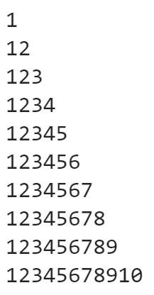
Brushing up on Java
Write Java Programs for the following:
Euclid’s Algorithm (Ask for User input for two numbers).
Arrange a sequence of numbers in Ascending & Descending order. Provide the user with a menu to select Ascending / Descending, repeat menu till user wishes to exit. Hard code the array of numbers. Modification: have user input the array of numbers.
Write a program in Java to display n terms of natural numbers and their sum. User inuts the value of n.
Write a program in Java to display the pattern like right angle triangle with a number. User inputs the number of rows.

